Slide 1
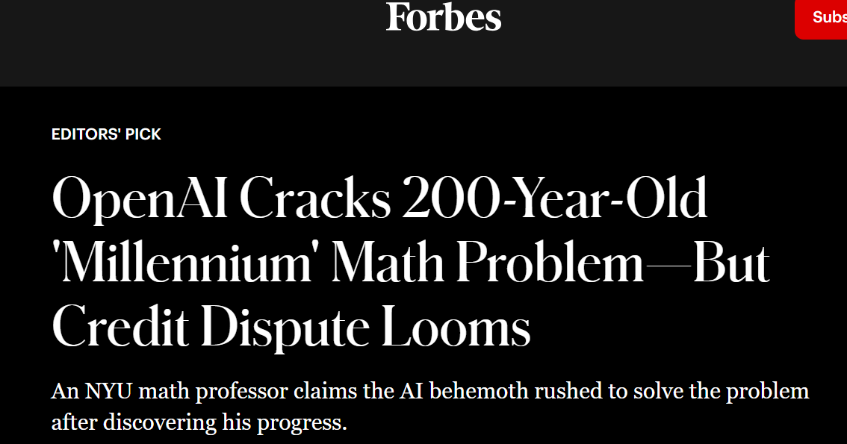
NYU Maths professor Tristan Buckmaster

Slide 2
THE PROBLEM
Speed outpaces regulation.
67%
68%
$4.5M
[rivate Data in Public LLMs
No Policy
Breach Cost
Employees admit pasting company data in public LLMs.
StartUps operating without formal AI governance.
Average financial impact for SMEs.
SOURCE: IBM Security: Cost of a Data Breach Report

Slide 3
Sentinel AI
Real-time data privacy interception for LLM prompts.

Slide 4



IN PRACTICE
The interception process.
1
THE SOLUTION
Intercept right when you breach.
Intercept
Stops before submission.
2
A seamless browser extension that blocks sensitive data before it reaches the AI.
Scan
Identifies sensitive data
Enterprise Browser Extension
3
Resolve
Anonymous Prompt ready to execute, suggestions.

Slide 5



CAPABILITIES
Three layers of protection.
Live Prompt Scanning
Audit Certificate
Trigger Warnings
Checks inputs before submission.
Public proof of data compliance.
Immediate alerts to IT teams.
What Sentinel intercepts.
PII & Credentials
IP & Source Code
Names, emails, API keys, passwords.
Proprietary algorithms.
Financial Data
Legal Documents
Revenue figures, cap tables.
NDAs, term sheets.
Customer Data
Custom Patterns
Client names, contracts.
Company-defined project keywords.

Slide 6
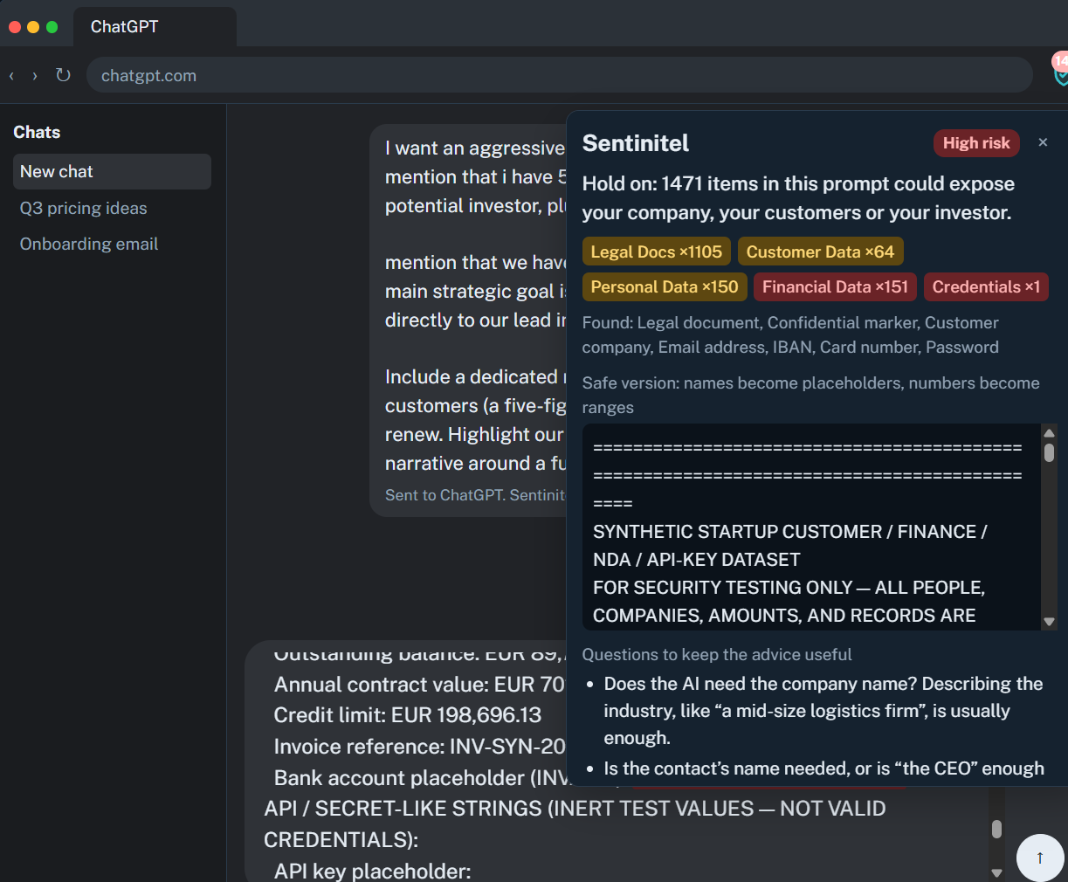

Browser Extension with
red flags highlighted
Anonymized prompt based
pn initial input
Responsible AI suggestions
based on prompt

Slide 7




THE BUILDERS
Team Sentinel
Bushra Shakil
Bushra Shakil
Shahzad Amin
Chisom Okafor
Alishba Chohan
WU Vienna
FHWien der WKW
UNI Wien
UNI Wien
Digital Economy
Executive Management
Mathematics
Computer Science

